Slide 1
DESIGN CREDIT
TOPIC: Datapath Extractor from Hardware Design Descriptions
Name of Supervisor: Binod Kumar
Risheek Nayak (B20AI058)
Suyash Jaiswal (B20EE070)

Slide 2
Problem Statement
A large circuit network is given in the form of verilog code.
There are n levels in between the input and output.
Our task is to reduce the network into single wired network (basically to reduce the large verilog code into simple expression or expressing the outputs in terms of only inputs rather than other wires of previous levels).

Slide 3
Our Approach
We had iterated the network level wise and stored the relation of each level wire with input wires.
We will go on iterating upto the last level where we will get the outputs in an expression containing only inputs.

Slide 4
Converting the Verilog netlist to a Graph format for simulation.
The nodes of the graph contain the following information:
Name of the gate.
Type of the gate.
The in-degree of the node.
The names of the incoming gates to the node.
The names of the input gates if any.
2. Function make_wire_gate_pair:
This function reads the Verilog file.
For each line in the file, it maps the gate’s output wire name to the gate’s name.

Slide 5
Converting the Verilog netlist to a Graph format for simulation.
3. Function construct_circuit:
Constructs the Verilog circuit into a graph format.
Now we can traverse the graph both from children to parent and from parent to children. This will help us to simulate the circuit.
4. Function output_value:
An output boolean value is generated depending on the type of gate (XNOR, XOR, AND, NOR, OR, BUF, NOT) and the input to the gate.
5. Function simulation:
Topological traversal is implemented.
Stores output of each and every gate.
Stores the name of gates per level.

Slide 6
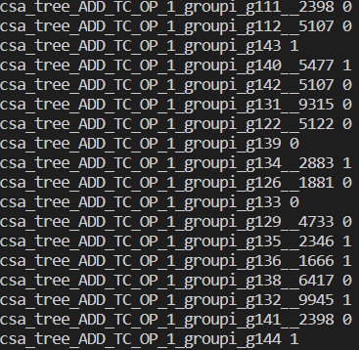
Converting the Verilog netlist to a Graph format for simulation.
6. Function all_inputs:
Recursively generates all the possible inputs for the input wires.
7. Function print_gate_with_output_value:
Prints all the gates with their respective output values.

Slide 7
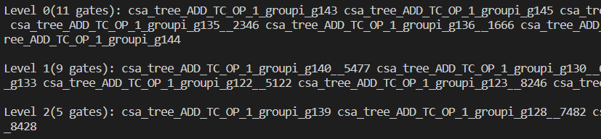
Converting the Verilog netlist to a Graph format for simulation.
8. Function print_gate_with_level:
Prints all the gates level-wise.

Slide 8
Generating the longest possible RTL
a.Function reverse:
it will reverse the key with values of the Wire_gate map and will create a new map.
b. Function relation_wire:
It will iterate the netlist level-wise.
It takes a string as a parameter and generates the output on the basis of the gates and wires of the previous level.
Returns the string which is the expression of level-wise outputs.

Slide 9
Generating the longest possible RTL
c. Function logic:
It will create a map that has keys as wires and their corresponding value as expressions from the wires and gates through which that output was generated.
d. Function form:
It will iterate on the wires level-wise and go on storing the expressions and replacing the terms which had already been stored in the map. For each level, we need outputs in the form of the first level in this way we will get the output of the last level in the form of the first.
For example, for level 2 we have wires in form of the first level and for level 3 we have wires in the form of level 2. Now we have an expression for level 2 so we will substitute that here so that we get the output of level 3 in the form of inputs of level 1. In this way, we get output at level n in the form of inputs of level 1.

Slide 10
Generating the longest possible RTL
Example Output:

Slide 11
Cross checking whether the longest expression is correct or not
a.Function gates:
It will take the input of two numbers and a string.
According to the string, it will check the gate and return the output.
b. Function evaluate_string:
This function uses stack data structure to evaluate the outputs as there are opening and closing brackets it cannot be done by simple iteration.
We will iterate on a string (expression) and will go on solving subproblems and store their result in the stack and go on solving that to generate the final output and verify this result from the simulator.

Slide 12
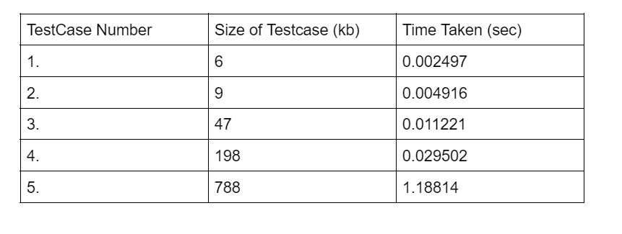
Analysis
Generating the datapath for different test cases and noting down the time it takes to run:

Slide 13
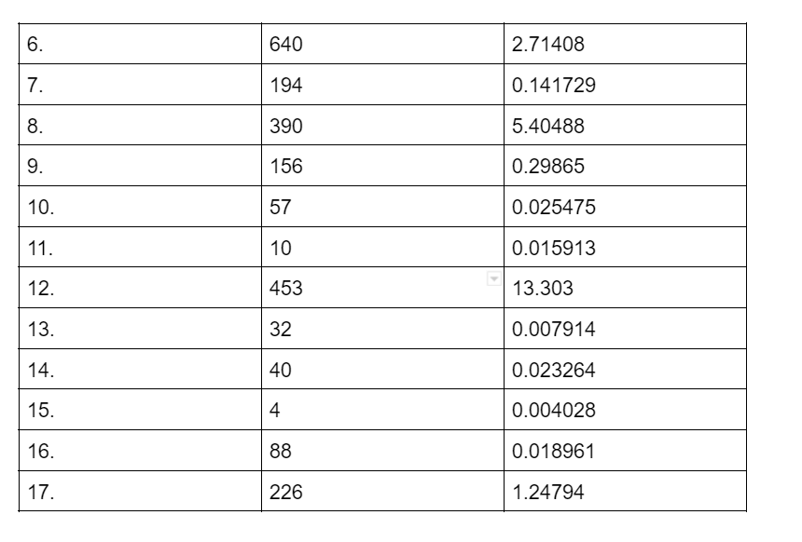
Analysis

Slide 14
Conclusion
The time taken not only depends on the size of the circuit, it also depends on the orientation of the circuit.

Slide 15
THANK YOU!

